Slide 1
Baltic Earth lauched at the 7th Study Conference on BALTEX, Borgholm, Öland, Sweden, 10-14 June 2013
Vision of the programme
To achieve an improved Earth System understanding of the Baltic Sea region
Interdisciplinary and international collaboration (conferences, workshops, joint projects etc.)
Holistic view on the Earth system of the Baltic Sea region, encompassing processes in the atmosphere, on land and in the sea and also in the anthroposphere
“Service to society” in the respect that thematic assessments provide an overview over knowledge gaps which need to be filled (e.g. by funded projects)
Education (summer schools)
Inherits the BALTEX network of scientists and infrastructure

Slide 2
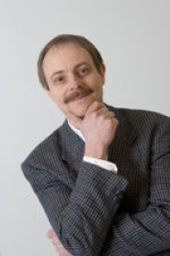
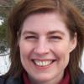
Baltic Earth Infrastructure
BESSG chairs
International Baltic Earth Secretariat at Helmholtz Zentrum Geesthacht
Baltic Earth Science Steering Group (BESSG) Excellent, active “young” scientists; country balance, gender balance, discipline balance, institutional balance, currently 19 members
Working Groups installed for each GC plus
WG on Outreach and Communication
WG on Education
WG on the Utility of Regional Climate Models
WG on the Assessment of Scenario Simulations for the Baltic Sea 1960-2100
WG on Regional Seas
Senior Advisory Board
Markus Meier, Head of Physical Oceanography, Baltic Sea Research Institute, Germany
Anna Rutgersson, Professor of Meteorology, Uppsala University, Sweden.
Both have been active in BALTEX for many years

Slide 3
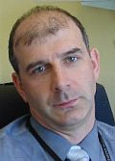
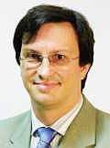
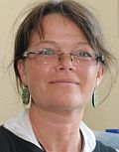
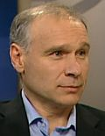
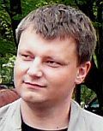
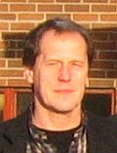
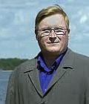
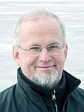
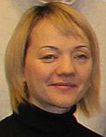
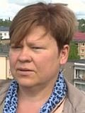
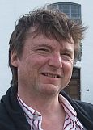
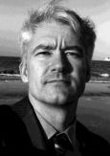
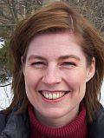
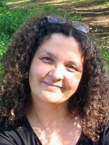
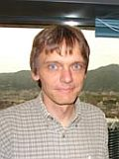
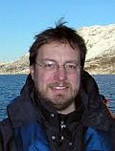
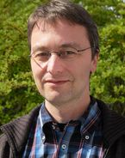
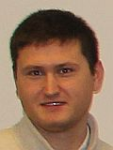
Members of the Baltic Earth Science Steering Group, as of January 2017
Juris Aigars Latvia
Franz Berger Germany
Inga Dailidienė
Lithuania
Jari Haapala Finland
Karol Kulinski Poland
Andreas Lehmann
Germany
Markus Meier
Germany
Kai Myrberg Finland
Anders Omstedt Sweden
Irina Partasenok Belarus
Piia Post Estonia
Marcus Reckermann Germany
Gregor Rehder Germany
Anna Rutgersson Sweden
Corinna Schrum Germany
Ben Smith Sweden
Martin Stendel Denmark
Ralf Weisse Germany
Sergey Zhuravlev
Russia

Slide 4
Grand Challenges and Science Plan
Grand Challenges
Flexible science plan with a continuously on-going definition of core research questions which are identified to be key scientific issues, so-called “Grand Challenges” (GCs)
New Grand Challenges will be identified at conferences and by using assessments of existing research by dedicated working groups. Grand Challenges are envisaged to be research foci for periods of about 3-4 years (then terminated or updated)
Communication with stakeholders and research funding agencies to promote funding relevant for the Grand Challenges
Contributing to GEWEX/WCRP
GC1: Salinity dynamics
GC2: Land-Sea biogeochemical linkages
GC3: Natural hazards and extreme events
GC4: Sea level and coastal dynamics dynamics
GC5: Regional variability of water and energy exchanges
GC6: Multiple drivers of regional Earth system changes
The human impact will be assessed at all levels, wherever possible and rational
Website www.baltic.earth
facebook.com/BalticEarth
twitter.com/BalticEarth
thebaccblog.blogspot.de

Slide 5
baltic.earth

