Slide 1
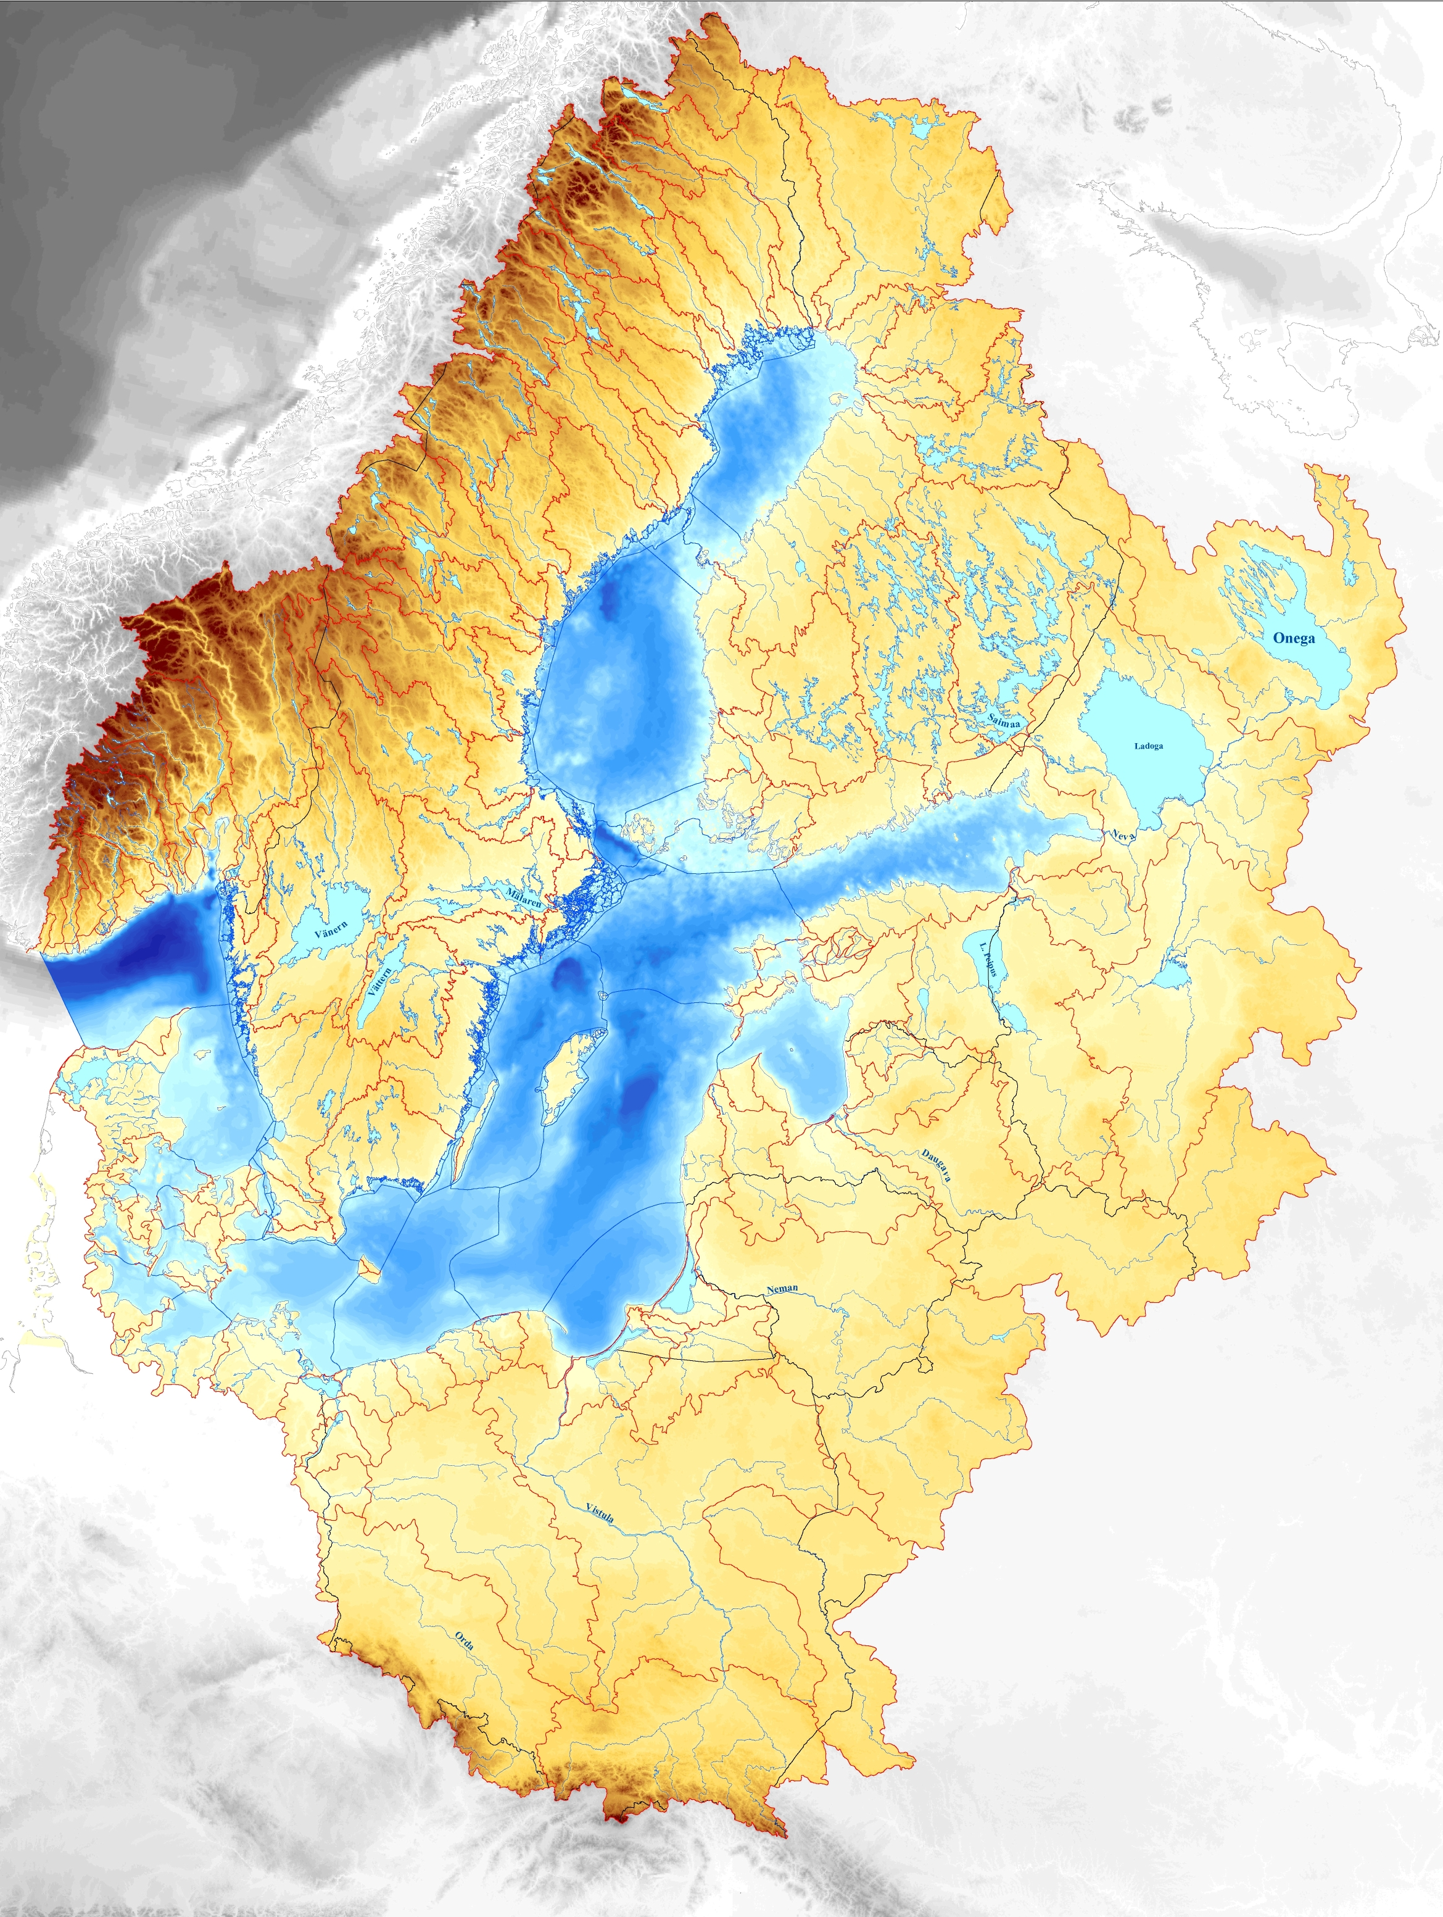

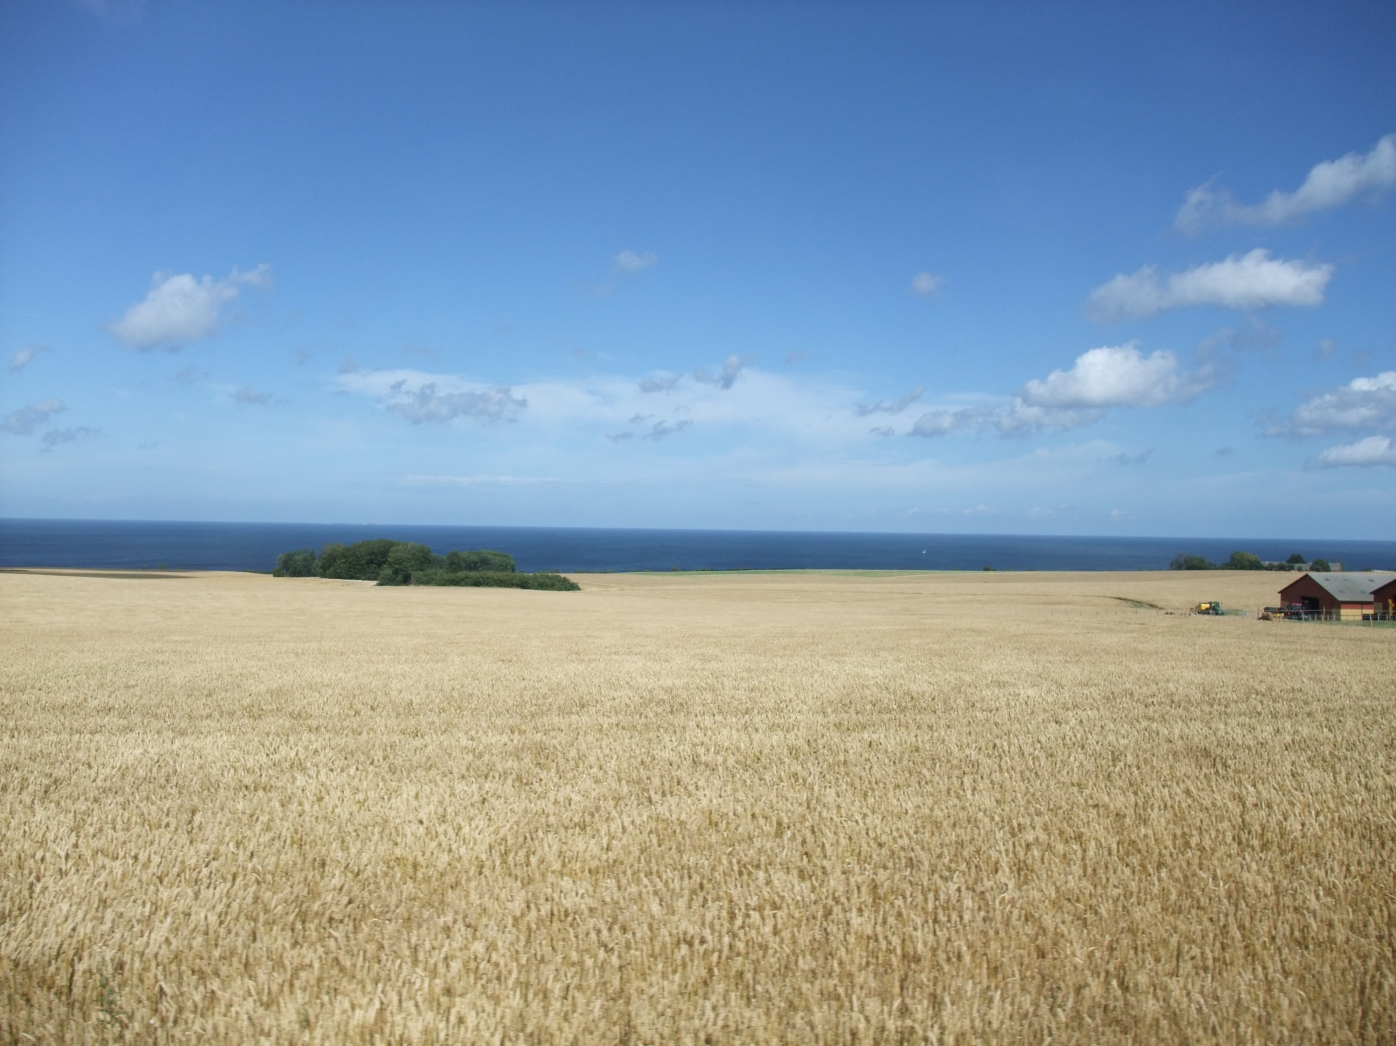
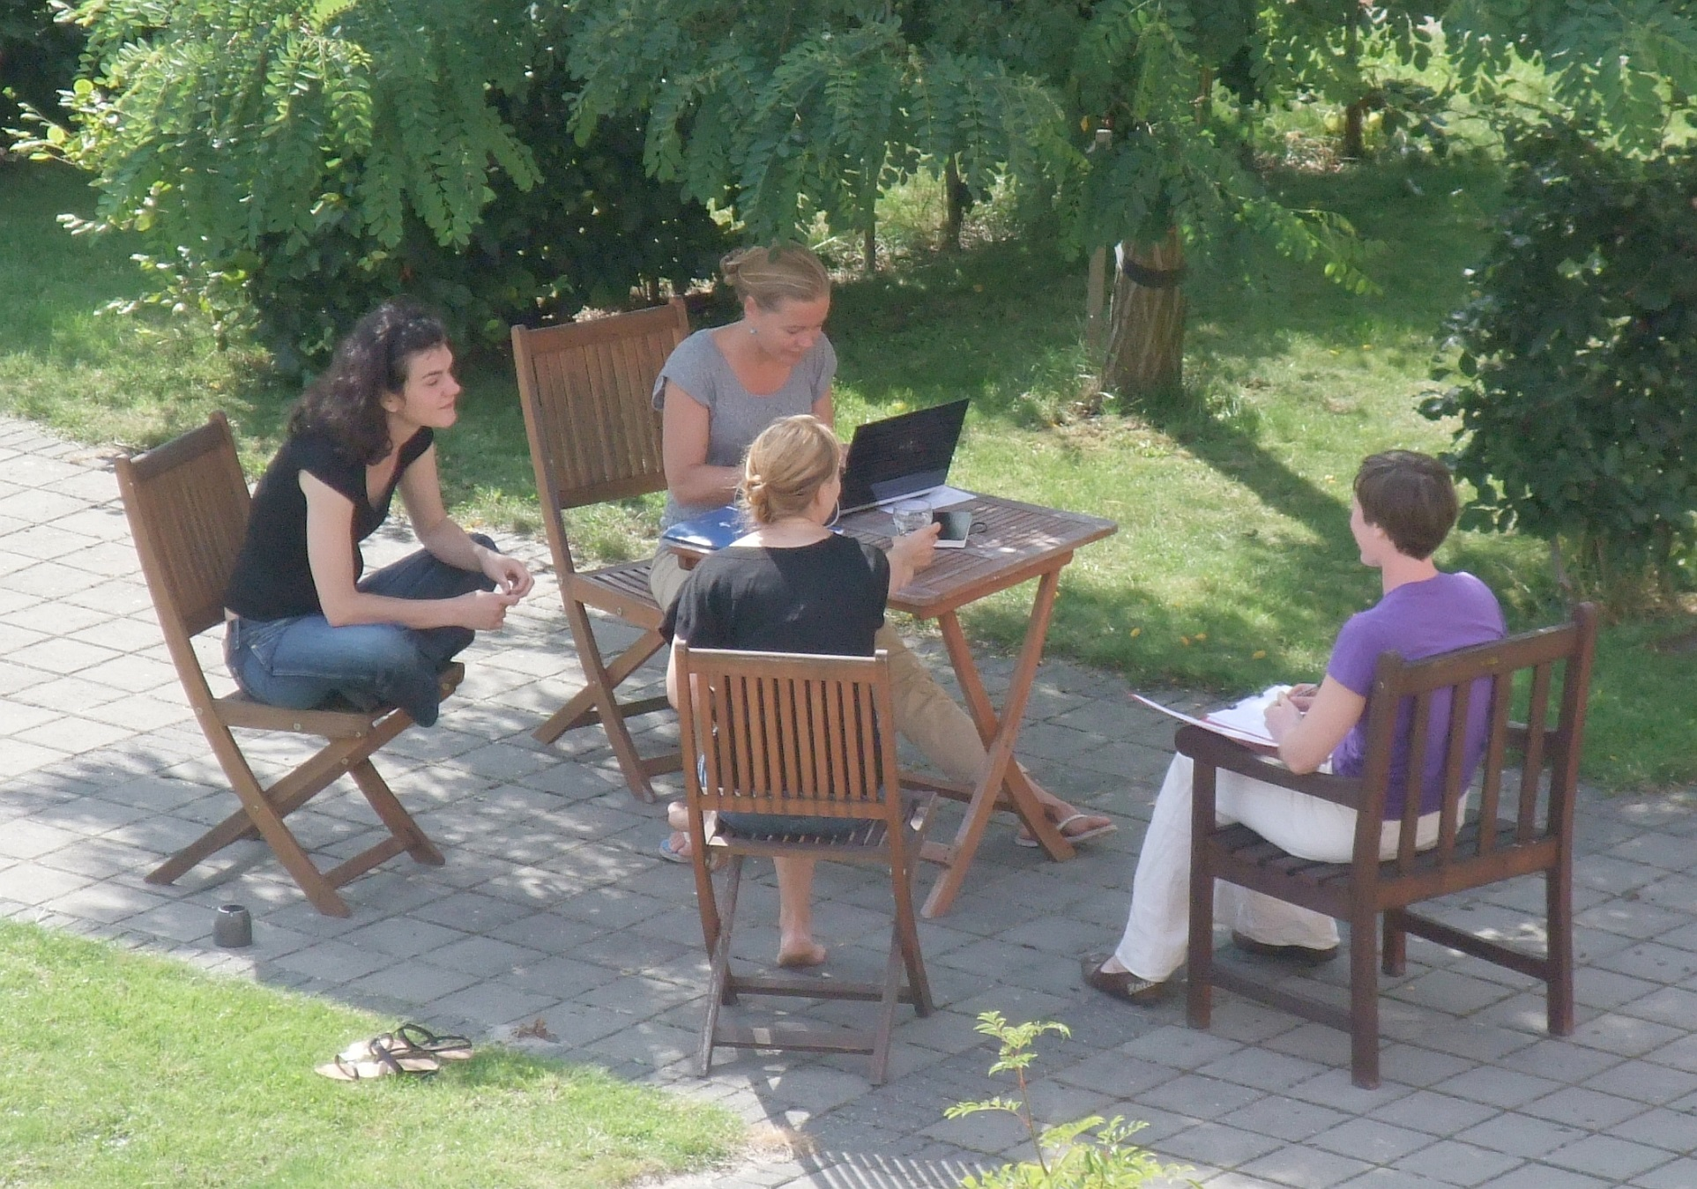
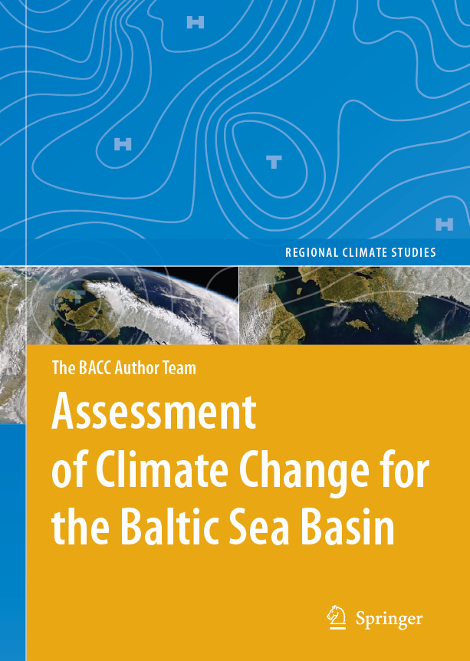

The International Baltic Earth Secretariat (IBES) is located at Helmholtz-Zentrum Geesthacht (Germany) as a focal support point for Baltic Earth. baltic.earth
Baltic Earth
Earth System Science for the Baltic Sea Region
An open research network to achieve an improved
Earth system understanding of the Baltic Sea region
Baltic Earth
succeeds BALTEX
Extending the knowledge of the regional Earth system in the Baltic Sea region
The goal of Baltic Earth is to achieve an improved Earth system understanding of the Baltic Sea region.
Baltic Earth is the successor to BALTEX that was terminated in June 2013 after 20 years and two
successful phases. The research components of BALTEX continue to be relevant, but now have a more
holistic focus encompassing processes in the atmosphere, on land and in the sea, as well as processes
and impacts related to the anthroposphere. Specific interdisciplinary research challenges have been
formulated by the Baltic Earth Interim Science Steering Group in 2013, to be approached by the new
programme in the coming years. The continuity in basic research fields, structure (secretariat,
conferences, publications) and the international network (people and institutions) is symbolized
by the logo, which is similar but still distinctly different from the BALTEX logo.
A major means of achieving the goals of Baltic Earth will be scientific assessments of particular research topics to be prepared by expert groups. Similar to the BACC approach, the assessments shall help to identify gaps and inconsistencies in the current knowledge. A Baltic Earth Science Plan was established in 2016, with a definition of core research questions, so-called “Grand Challenges”. They are currently:
Salinity dynamics in the Baltic Sea
Land-Sea biogeochemical feedbacks in the Baltic Sea region
Natural hazards and extreme events in the Baltic Sea region
Understanding sea level dynamics in the Baltic Sea
Understanding regional variability of water and energy exchanges
Multiple drivers for regional Earth system changes
The Grand Challenges are intended as flexible, regularly updated research topics and will be dealt
with by specific working groups. The working groups on the “Regional Climate Models”,
and “Scenario Simulations for the Baltic Sea 1960-2100“ will continue in Baltic Earth.
Dedicated working groups have also been established on “Outreach and Communication” and “Education”.
The human impact shall be assessed at all levels, wherever possible and reasonable. New Grand Challenges and modifications of existing ones can be implemented by the steering committee and the working groups, by using the assessments of existing research and knowledge, and the open discussions at conferences and workshops. The Grand Challenges are foreseen as research foci for periods of about 3-4 years (then terminated or updated). Baltic Earth is internationally embedded, collaborating with similar regions in Europe and the world.
Baltic Earth intends to provide a “service to society” in the respect that the assessments may provide an overview of knowledge gaps, and the communication with different stakeholders may help to identify open scientific questions relevant for society, which could be approached by funded research projects.
Baltic Earth is committed to educational activities with the establishment of regular
Baltic Earth Summer Schools, the first two of which took place in in 2015. The first
dedicated Baltic Earth Conference tooks place in Nida, Lithuania13-17 June 2016.
Conference topic was “Multiple drivers of Earth system changes
in the Baltic Sea region”
Image provided by the SeaWiFS Project,NASA/Goddard Space Flight Center and ORBIMAGE.
Assessment projects similar to BACC will be concrete outcomes of Baltic Earth
“Products” of Baltic Earth include: Conferences, Workshops,
Assessment Projects, Research Projects, Summer Schools
and Courses.
The Baltic Earth Science Steering Group (as of January 2017): Markus Meier (Chair), Anna Rutgersson (Vice-Chair), Juris Aigars, Franz Berger, Inga Dailidienė, Jari Haapala, Karol Kulinski, Andreas Lehmann, Kai Myrberg, Anders Omstedt, Irina Partasenok, Piia Post, Marcus Reckermann, Gregor Rehder, Corinna Schrum,
Benjamin Smith, Martin Stendel, Ralf Weisse, Sergey Zhuravlev

